Slide 1

Unit 01.04.1 CS 5220: COMPUTER COMMUNICATIONS
Error Control – Parity Checks
XIAOBO ZHOU, Ph.D.
Professor, Department of Computer Science

Slide 2
Error Control
Digital transmission systems introduce errors with different error probability (bit-error-rate)
Applications require certain reliability level
Error control used when transmission system does not meet application requirement
Error control ensures a data stream is transmitted to a certain level of accuracy despite errors
Two basic approaches:
Error detection & retransmission
Error correction

Slide 3
Codeword
A n-bit codeword: a frame of m-bit data plus k-bit redundant check bits (n = m + k)

Slide 4
Key Idea
All transmitted data blocks “codewords” satisfy a pattern
If received block doesn’t satisfy pattern, it is in error
Blindspot: when channel transforms a codeword into another codeword
All inputs to channel
satisfy pattern or condition
Channel
output
Deliver user
information or
set error alarm
User
information
Encoder
Channel
Pattern
checking
codeword
codeword

Slide 5
Single Parity Check
Append an overall parity check to k information bits
Info Bits: b₁, b₂, b₃, …, b_{k}
Check Bit: b_{k+1}= b₁+ b₂+ b₃+ …+ b_{k} modulo 2
Codeword: (b₁, b₂, b₃, …, b_{k,}, b_{k+!})
All codewords have even # of 1s
Receiver checks to see if # of 1s is even
Parity bit used in ASCII code

Slide 6
Example of Single Parity Code
Information (7 bits): (0, 1, 0, 1, 1, 0, 0)
Parity Bit: b₈ = 0 + 1 +0 + 1 +1 + 0 = 1
Codeword (8 bits): (0, 1, 0, 1, 1, 0, 0, 1)
If single error in bit 3 : (0, 1, 1, 1, 1, 0, 0, 1)
# of 1’s =5, odd
Error detected
If errors in bits 3 and 5: (0, 1, 1, 1, 0, 0, 0, 1)
# of 1’s =4, even
Error not detected

Slide 7
How good is the single parity check code?
Redundancy: Single parity check code adds 1 redundant bit per m information bits: overhead = 1/(m + 1)
Coverage: all error patterns with odd # of errors can be detected
An error patten is a binary (m + 1)-tuple with 1s where errors occur and 0’s elsewhere
Of 2^{k+1} binary (m + 1)-tuples, ½ are odd, so 50% of error patterns can be detected
Code vector (e₁, e₂, …, e_{n}) where e_{i} = 1 if an error occurs in the i_{th} transmitted bit and e_{i} = 0 otherwise

Slide 8
Error Probability
Many transmission channels introduce bit errors at random, independently of each other, and with probability p
For a n-bit frame,
1
n
P [1-bit error] = p (1 – p) ^{n-1} and
P [ j-bit error] = p ^{j} (1 – p) ^{n-j}
j
n

Slide 9
What if bit errors are random?
Some error patterns are more probable than others:
p
1 – p
P [10000000] = p(1 – p)⁷ = (1 – p)⁸ and
P [11000000] = p²(1 – p)⁶ = (1 – p)⁸
p ²
1 – p
In any worthwhile channel p < 0.5, and so (p/(1 – p) < 1)
It follows that patterns with 1 error are more likely than patterns with 2 errors and so forth

Slide 10
Single Parity – Undectable errors
What is the probability an undetectable error pattern occurs?
Undetectable error pattern if even # of bit errors:
P [error detection failure] = P [undetectable error pattern]
= P [error patterns with even number of 1s]
= p²(1 – p)^{n-2} + p⁴(1 – p)^{n-4} + …
n
2
n
4
Example: evaluate above for n = 32, p = 10⁻³ , roughly 1 in 2000 error patterns is undetectable
Is it possible to detect more errors if we add more check bits?

Slide 11
Two-Dimensional Parity Check
More parity bits to improve coverage
Arrange information as columns
Add single parity bit to each column
Add a final “parity” column
1 0 0 1 0 0
0 1 0 0 0 1
1 0 0 1 0 0
1 1 0 1 1 0
1 0 0 1 1 1
Last column consists of check bits for each row
Bottom row consists of check bit for each column

Slide 12
Error-detecting capability
1 0 0 1 0 0
0 0 0 0 0 1
1 0 0 1 0 0
1 1 0 1 1 0
1 0 0 1 0 0
0 0 0 0 0 1
1 0 0 1 0 0
1 0 0 1 1 0
1 0 0 1 1 1
One error
Two errors
1 0 0 1 1 1

Slide 13
Error-detecting capability - II
1 0 0 1 0 0
0 0 0 1 0 1
1 0 0 1 0 0
1 0 0 1 1 0
1 0 0 1 1 1
1 0 0 1 0 0
0 0 0 1 0 1
1 0 0 1 0 0
1 0 0 0 1 0
1 0 0 1 1 1
Three errors
Four errors (undetectable)
Arrows indicate failed check bits

Slide 14
Summary of the Lesson
Single parity bit code is used in ASCII. Its overhead is low, but able to detect any odd number of errors, including the most possible 1-bit errors.
Two-dimensional parity checks was used in old systems, as it was able to detect 1, 2, and 3 bit errors. But its overhead is high.

Slide 15
Unit 01.04.02 CS 5220: COMPUTER COMMUNICATIONS
Error Control – Polynomial Codes (CRC)
XIAOBO ZHOU, Ph.D.
Professor, Department of Computer Science

Slide 16
Polynomial Codes
Polynomial arithmetic instead of check sums
Implemented using shift-register circuits
Also called cyclic redundancy check (CRC) codes
Most data communications standards use polynomial codes for error detection
Polynomial codes also basis for powerful error-correction methods

Slide 17
Binary Polynomial Arithmetic
Binary vectors map to polynomials (polynomial degree k-1)
(i_{k-1} , i_{k-2} ,…, i₂ , i₁ , i₀) → i_{k-1}x^{k-1} + i_{k-2}x^{k-2} + … + i₂x² + i₁x + i₀
Addition:
(x⁷ + x⁶ + 1) + (x⁶ + x⁵) = x⁷ + x⁶ + x⁶ + x⁵ + 1
= x⁷ +(1+1)x⁶ + x⁵ + 1
= x⁷ +x⁵ + 1 since 1+1=0 mod2
Multiplication:
(x + 1) (x² + x + 1) = x(x² + x + 1) + 1(x² + x + 1)
= x³ + x² + x + x² + x + 1
= x³ + 1

Slide 18
Division
Division with Decimal Numbers (Euclidean Division)
4
3
quotient
dividend = quotient x divisor + remainder
35 ) 1222
dividend
105
1222 = 34 x 35 + 32
divisor
17
2
140
32
remainder

Slide 19
Binary Polynomial Division
Polynomial Division, p(x) = q(x) g(x) + r(x)
x³
+ x²
+ x
= q(x) quotient
x³ + x + 1 ) x⁶ + x⁵
Dividend p(x)
x⁶ + x⁴ + x³
Divisor g(x)
x ⁵+x⁴ +x³
x⁵ + x³ + x²
x⁴ + x²
x⁴ + x² + x
Note: Degree of r(x) is less than degree of divisor
x
= r(x) remainder

Slide 20
Cyclic Redundancy Check
Cyclic Redundancy Check (CRC) uses polynomial code, treating bit strings as representation of polynomials with coefficients of 0 and 1 only.
A k-bit data frame is regarded as the coefficient list for a polynomial with k terms, ranging from x^k-1 to x^0. Such a polynomial is said to be of degree k-1
Polynomial arithmetic is done by per-bit XOR
Examples: 10011011 + 11001010
11110000 - 10100110

Slide 21
CRC Idea - Checkbits & Error Detection
Information k bits
Received information bits
Recalculate check bits
Generator
Polynomial
k bits
Channel
Calculate check bits
Compare
Sent check
bits
Information accepted if check bits match
Received check bits
Generator
Polynomial
n – k bits

Slide 22
CRC Procedure - Preparation
Given a generator polynomial g(x) that has degree n-k
g(x) = x^{n-k} + g_{n-k-1}x^{n-k-1} + … + g₂x² + g₁x + 1
Information polynomial i(x) has k information bits (degree k – 1)
i(x) = i_{k-1}x^{k-1} + i_{k-2}x^{k-2} + … + i₂x² + i₁x + i₀

Slide 23
CRC Encoding Procedure
Multiply i(x) by n-k; (puts n-k zeros in (n-k) low order positions)
Divide x^{n-k} i(x) by g(x), and get a remainder polynomial r(x) of at most degree n-k-1. The remainder is the CRC checkbits;
Add remainder r(x) to x^{n-k} i(x); (put check bits in the n-k lower-order positions). The resulted polynomial will be transmitted codeword
q(x)
g(x) ) x^{n-k} i(x)
x^{n-k}i(x) = q(x)g(x) + r(x)
r(x)
b(x) = x^{n-k} i(x) + r(x)

Slide 24
CRC Polynomial example: k = 4, n–k = 3
Generator polynomial: g(x)= x³ + x + 1
Information: (1,1,0,0) i(x) = x³ + x²
Encoding dividend: x³i(x) = x⁶ + x⁵

Slide 25
x³ + x² + x
1110
x³ + x + 1 ) x⁶ + x⁵
1011 ) 1100000
x⁶ + x⁴ + x³
1011
x⁵ + x⁴ + x³
1110
x⁵ + x³ + x²
1011
x⁴ + x²
1010
x⁴ + x² + x
1011
x
010
Remainder (check bits)
Transmitted codeword:
b(x) = x⁶ + x⁵ + x
b = (1,1,0,0,0,1,0)

Slide 26
Summary of the Lesson
Binary polynomial code and binary arithmetic are key to CRC encoding and checkbits calculation

Slide 27
Unit 01.04.03 CS 5220: COMPUTER COMMUNICATIONS
CRC Capability; Internet Checksum
XIAOBO ZHOU, Ph.D.
Professor, Department of Computer Science

Slide 28
CRC Encoding - Recab
Multiply i(x) by n-k; (puts n-k zeros in (n-k) low order positions)
Divide x^{n-k} i(x) by g(x), and get a remainder polynomial r(x) of at most degree n-k-1. The remainder is the CRC checkbits;
Add remainder r(x) to x^{n-k} i(x); (put check bits in the n-k lower-order positions). The resulted polynomial will be transmitted codeword
b(x) = x^{n-k} i(x) + r(x)

Slide 29
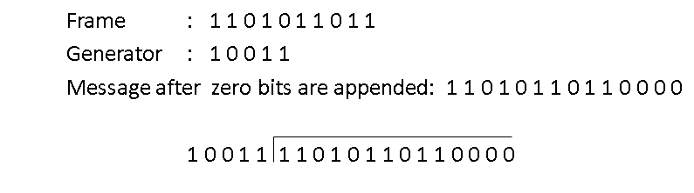
An Example – Step-by-Step

Slide 30
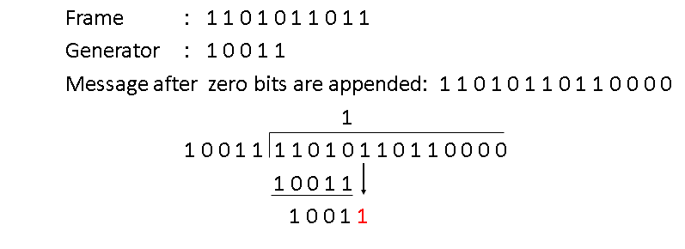
An Example – Step 1

Slide 31
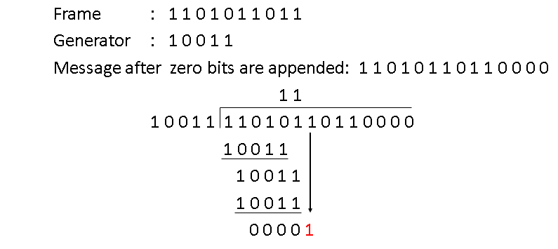
An Example – Step 2

Slide 32
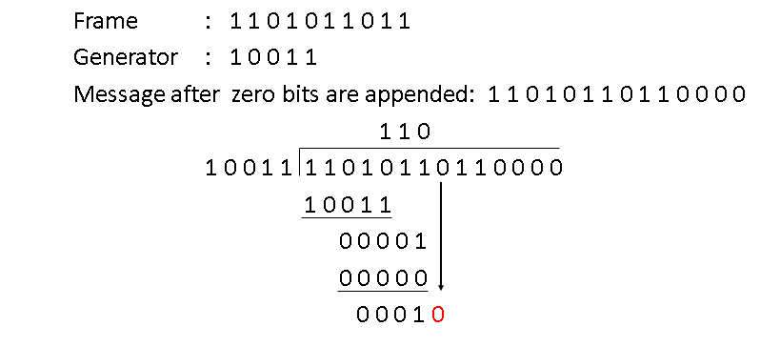
An Example – Step 3

Slide 33
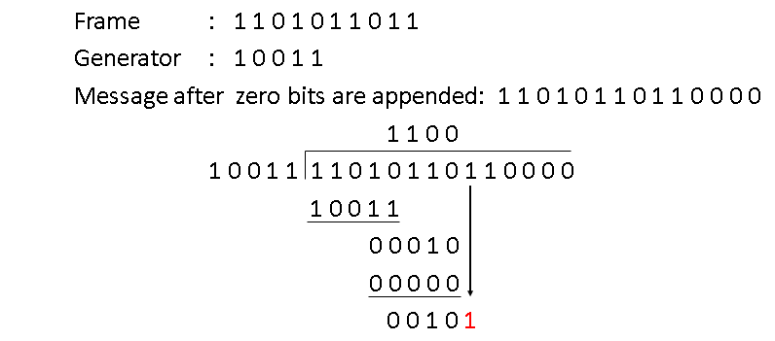
An Example – Step 4

Slide 34
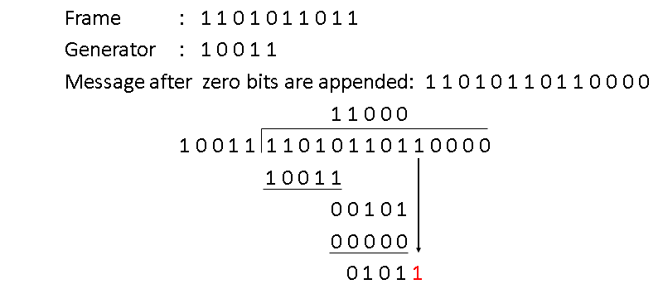
An Example – Step 5

Slide 35
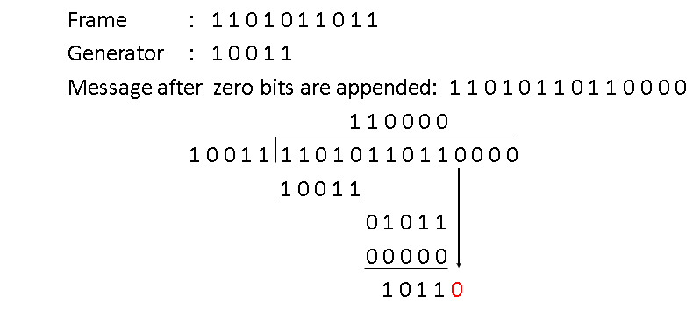
An Example – Step 6

Slide 36
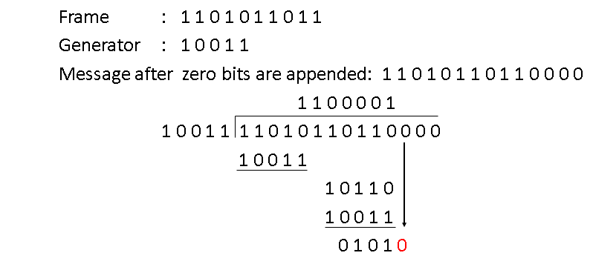
An Example – Step 7

Slide 37
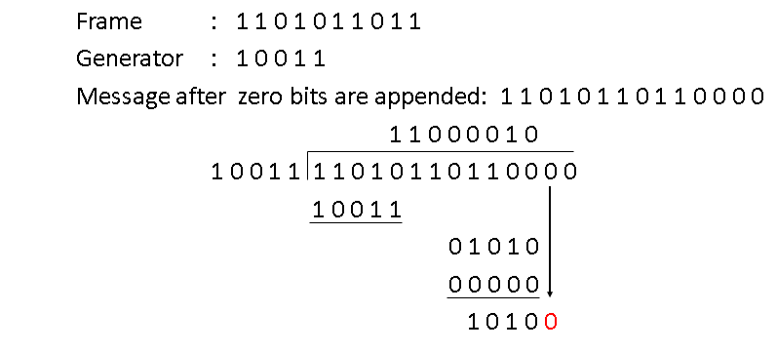
An Example – Step 8

Slide 38
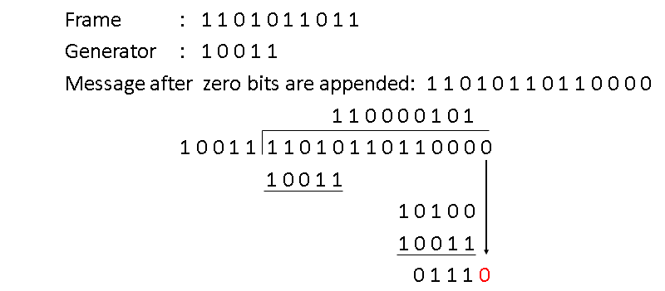
An Example – Step 9

Slide 39
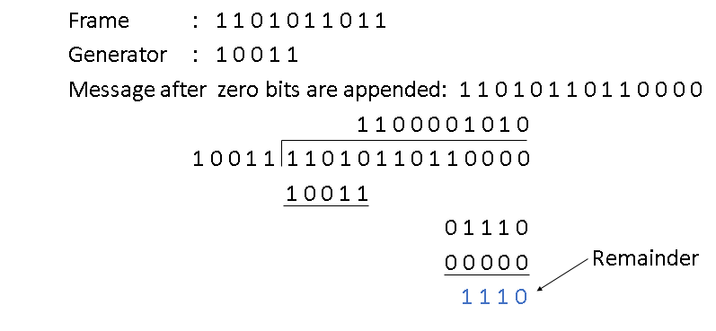
An Example – Step 10

Slide 40
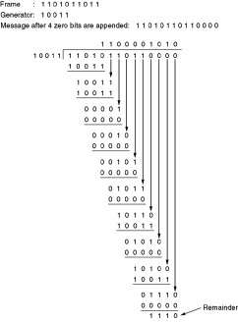
Overall

Slide 41
CRC Capability Analysis
What kind of errors will be detected?
Imagine that a transmission error e(x) occurs, so that instead of b(x) arriving, b(x) + e(x) arrives.
e(x) has 1s in error locations & 0s elsewhere, an additive error model adding bit-by-bit to the input codeword b(x) using modulo 2 arithmetic
(Transmitter)
(Receiver)
b(x)
+
R(x)=b(x)+e(x)
e(x)
Error polynomial
(Channel)

Slide 42
Undetectable Error Patterns
Receiver divides the received polynomial R(x) by g(x)
Blindspot: If e(x) is a multiple of g(x), that is, e(x) is a nonzero codeword, then
R(x) = b(x) + e(x) = q(x)g(x) + q’(x)g(x)
If e(x) is divisible by g(x), the error will slip by! So, how we select g(x)?
(Transmitter)
(Receiver)
b(x)
+
R(x)=b(x)+e(x)
e(x)
Error polynomial
(Channel)

Slide 43
Designing Good Polynomial Codes
Select generator polynomial so that likely error patterns are not multiples of g(x)
Detecting Single Errors
e(x) = x^{i} for error in location i + 1
If g(x) has more than 1 term, it cannot divide x^{i}
Detecting Double Errors
e(x) = x^{i} + x^{j} = x^{i}(x^{j-i}+1) where j>i
If g(x) has more than 1 term, it cannot divide x^{i}
If g(x) is a primitive polynomial, it cannot divide x^{m}+1 for all m<2^{n-k}-1 (Need to keep codeword length less than 2^{n-k}-1)
Primitive polynomials can be found by consulting coding theory books

Slide 44
Designing Good Polynomial codes
Detecting Odd Numbers of Errors
Suppose all codeword polynomials have an even # of 1s, then all odd numbers of errors can be detected
As well, b(x) evaluated at x = 1 is zero because b(x) has an even number of 1s
This implies x + 1 must be a factor of all b(x)
Pick g(x) = (x + 1) p(x) where p(x) is primitive

Slide 45
Standard CRC Generator Polynomials
CRC-8:
CRC-16:
CCITT-16:
CCITT-32:
ATM
= x⁸ + x² + x + 1
Bisync
= x¹⁶ + x¹⁵ + x² + 1
= (x + 1)(x¹⁵ + x + 1)
HDLC, XMODEM, V.41
= x¹⁶ + x¹² + x⁵ + 1
IEEE 802, DoD, V.42
= x³² + x²⁶ + x²³ + x²² + x¹⁶ + x¹² + x¹¹ + x¹⁰ + x⁸ + x⁷ + x⁵ + x⁴ + x² + x + 1

Slide 46
Internet Checksum
Internet Protocols (IP, TCP, UDP) use check bits to detect errors, instead of using CRC polynomial
The rationale is the simplicity: the checksum must be recalculated at every router, the algorithm for the checksum was selected for its ease of implementation, instead of strength of error detection capability

Slide 47
Internet (IP) Checksum Algorithm
Let IP header consists of L, 16-bit words, b₀, b₁, b₂, ..., b_{L-1}
The algorithm appends a 16-bit checksum b_{L} to the header. The checksum b_{L} is calculated as follows:
Treating each 16-bit word as an integer, find
x = (b₀ + b₁ + b₂+ ...+ b_{L-1} ) modulo 2¹⁶-1
The checksum is then given by: b_{L} = - x
Thus, the headers must satisfy the following pattern:
0 = (b₀ + b₁ + b₂+ ...+ b_{L-1} + b_{L} ) modulo 2¹⁶-1
The checksum calculation is carried out in software using one’s complement arithmetic

Slide 48
Internet Checksum Example
Assume 4-bit words
Use mod 2⁴-1 arithmetic
b0=1100 = 12
b1=1010 = 10
Use Modulo Arithmetic
Use Binary Arithmetic

Slide 49
Internet Checksum Example
Use Modulo Arithmetic
Assume 4-bit words
Use mod 2⁴-1 arithmetic
b₀=1100 = 12
b₁=1010 = 10
b₀+b₁=12+10=7 mod15
b₂ = -7 = 8 mod15
Therefore
b₂=1000
Use Binary Arithmetic
Note 16 mod15 =1
So: 10000 mod15 = 0001
leading bit wraps around
b₀ + b₁ = 1100+1010
=10110
=10000+0110
=0001+0110
=0111
=7
Take 1s complement b₂ = -0111 =1000

Slide 50
Summary of the Lesson
Choosing good generator polynomial codes determine the capability of CRC error detection.
Internet checksum values more on ease of implementation than on detection capability.

